Slide 1
CloudWiseAI
BCSE355L · CLOUD ARCHITECTURE DESIGN · TEAM 3
AI-based FinOps framework for MSME cloud cost optimization using predictive analysis
Rahul Ganesan
24BIT0257
Ridhima Singh
24BIT0260
Akhilesh Reddy
24BIT0352
VIT · B.Tech IT · Faculty: Dr. Priya V. · October 2026
Notes:
Introduce the project in one sentence: CloudWiseAI helps a small business see where its AWS money goes, predicts the next three months of spend, flags unusual spending and recommends concrete savings. Name the team members.

Slide 2
Small businesses learn what the cloud cost them only when the invoice arrives
No FinOps team
Bills look backward
Waste hides
One or two engineers who also run deployments, so cost control is reactive.
Billing consoles report what was spent. They do not predict next month or explain what is wasted.
Over-sized servers, unattached disks and storage on the wrong tier quietly add up.
CloudWiseAI · BCSE355L
2
Notes:
Set up the problem. An MSME on AWS typically has no dedicated FinOps person. The native console shows history, not a forecast and not an explanation of waste. That is the gap this project targets.

Slide 3
CloudWiseAI turns daily billing data into three decisions
1 · FORECAST
2 · DETECT
3 · RECOMMEND
Next 3 months of spend
Abnormal spending
Ranked savings
Weekday-aware baseline finds all 8 injected events with no false alarms.
Six rules with written assumptions: about $7,507 per month on the test data.
Ridge model chosen by rolling-origin backtest: 0.45% mean monthly error.
Delivered as a React dashboard on a FastAPI and PostgreSQL backend, plus an optional assistant that answers only from the user’s own data.
CloudWiseAI · BCSE355L
3
Notes:
Three decision aids. All numbers are from the synthetic dataset and are optimistic; we say so explicitly later.

Slide 4
None of the 15 papers we reviewed combines forecasting, spend anomalies and explained savings
What the literature does
What CloudWiseAI adds
Forecasting, workload prediction, anomaly detection and optimisation are each studied in depth, but separately.
One system on resource-level daily billing data.
Tested against two baselines: a seasonal-naive forecaster and a rolling 3-sigma detector.
Mostly on simulators, public traces or price lists, not a customer’s own billing records.
Recommendations whose savings assumptions are written down.
CloudWiseAI · BCSE355L · Sources: project report, Sections 2 and 4
4
Notes:
We reviewed 15 recent papers from MDPI, Springer, Nature Portfolio and Emerald. Our claim is modest: we do not invent a new forecasting algorithm; the contribution is an integrated, evaluated workflow for MSMEs.

Slide 5
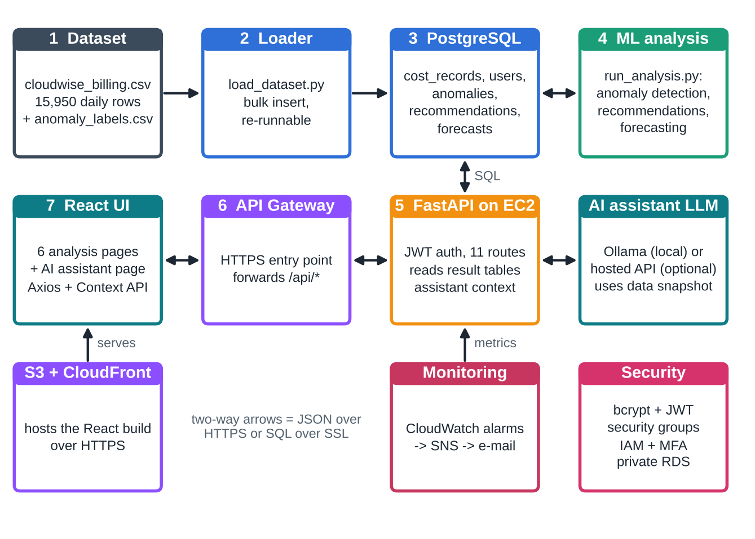
System architecture
Billing CSV is loaded into PostgreSQL.
One analysis script writes anomalies, recommendations and a 3-month forecast to result tables.
FastAPI serves them to the React dashboard with JWT sign-in.
CloudWiseAI · BCSE355L · Source: report, Figure 2
5
Notes:
Walk the flow left to right: data in, three analyses, API, dashboard. The assistant is optional and reads a compact snapshot of the user’s own data.

Slide 6
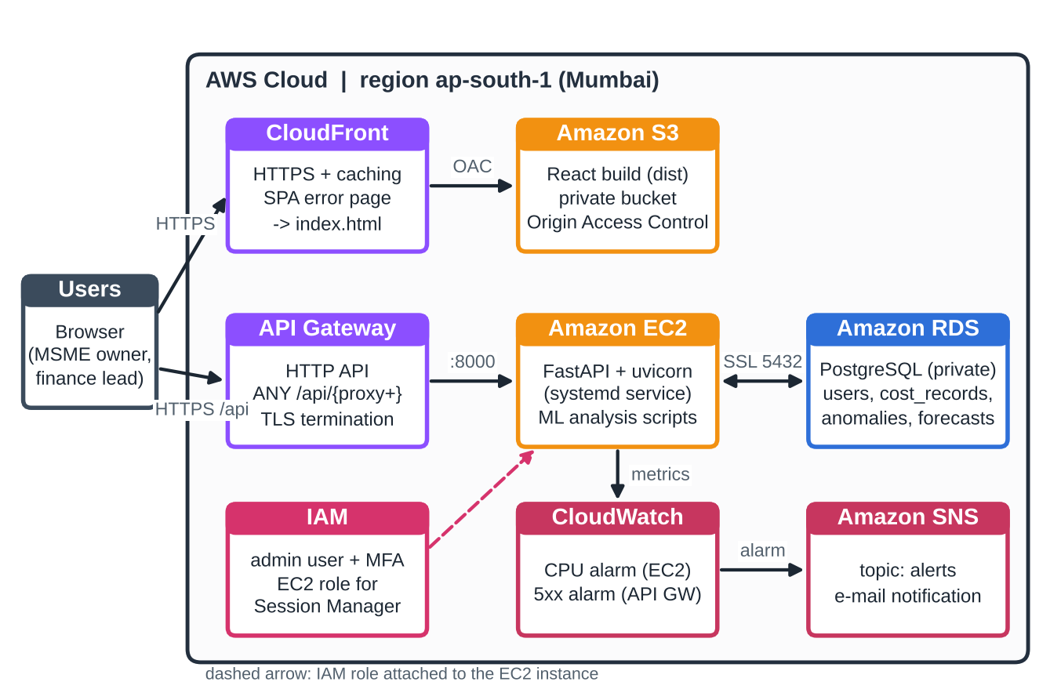
AWS architecture (designed)
CloudFront + S3: private bucket, HTTPS frontend
API Gateway + EC2: HTTPS entry to FastAPI
RDS PostgreSQL: private, reachable only from EC2
IAM, CloudWatch, SNS: access, alarms, e-mail alerts
Status: designed and scripted. Live deployment pending.
CloudWiseAI · BCSE355L · Source: report, Figure 1, Section 7
6
Notes:
Be upfront: this is the designed architecture for region ap-south-1 and we have a one-script EC2 setup and a step-by-step guide, but we have not yet run the live deployment. Lambda ingestion, SageMaker and QuickSight from the original target design are future work.

Slide 7
A synthetic dataset modelled on the AWS Cost and Usage Report
15,950
25
638
8
daily records
resources, 7 services
days, Jan 2025 to Sep 2026
injected anomaly events
9 columns: date, billing period, service, region, resource ID, usage hours, storage, CPU use, cost. About $495,700 total spend, EC2 the largest share. Generated with a fixed seed so results can be reproduced. No real customer data was available.
CloudWiseAI · BCSE355L · Source: report, Section 6
7
Notes:
Say clearly that the data is synthetic. The anomaly labels are used only to evaluate the detector. A real CUR export can be mapped to the same columns.

Slide 8
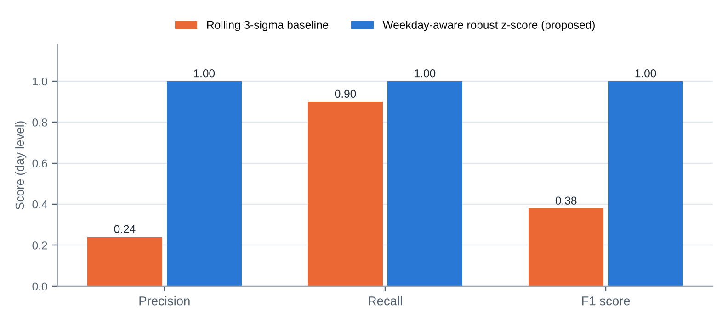
Weekday-aware detector: 8 of 8 events found, no false alarms
Weekday-aware robust z-score
precision 1.00 · recall 1.00
Rolling 3-sigma baseline
precision 0.24 · recall 0.90
57 false-alarm events
Baseline per resource: median and MAD of the same weekday over 8 weeks. Flag when z ≥ 4 and cost ≥ 1.4× expected.
CloudWiseAI · BCSE355L · Synthetic data, so optimistic · Source: report, Section 10.2
8
Notes:
A plain rolling 3-sigma rule flags every weekday dip and spike, which is why it raises 57 false-alarm events. Comparing each day with the same weekday in earlier weeks removes that. The injected anomalies are large, so a perfect score here will not carry over to real invoices.

Slide 9
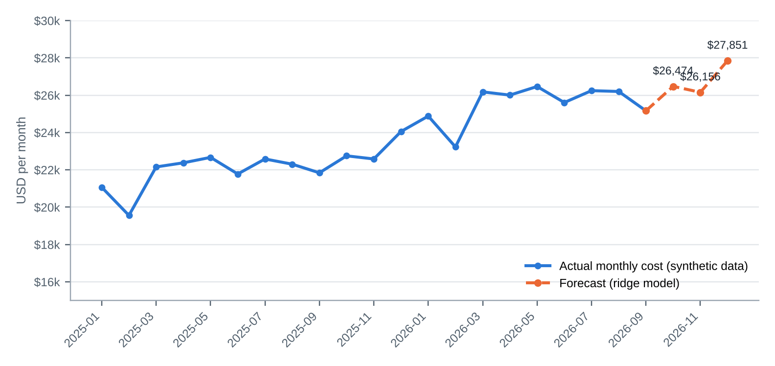
Forecast: ridge model reaches 0.45% monthly error against 2.47% for the baseline
Rolling-origin backtest, 7 origins, horizons 1 to 3 months
Ridge 0.45% · ridge + XGBoost 0.48% · seasonal-naive 2.47%
Forecast: Oct $26,474 · Nov $26,156 · Dec $27,851 (2026)
The data is generated from trend, weekday and yearly terms that ridge fits exactly, so real data will be harder.
CloudWiseAI · BCSE355L · Synthetic data, so optimistic · Source: report, Section 10.2
9
Notes:
Three candidates were compared with the same backtest and the simplest good one was chosen. XGBoost added nothing because no nonlinear structure is left in the residuals. The UI shows measured backtest accuracy, not a statistical confidence interval.

Slide 10
Six recommendations worth about $7,507 per month
Recommendation | Est. saving / month
Right-size 4 under-used EC2 instances | $3,516.52
Buy a Savings Plan | $1,371.53
S3 lifecycle: move cold data to cheaper tiers | $1,183.82
RDS reserved instance | $854.09
Remove 3 unattached EBS volumes | $306.73
Right-size 1 RDS instance | $274.23
Total: $7,506.92 per month, about 30% of current spend. Each rule names its resources and its assumption.
CloudWiseAI · BCSE355L · Upper bound on synthetic data · Source: report, Section 10.2
10
Notes:
The savings come from documented rules, for example CPU utilisation thresholds for right-sizing and typical Savings Plan discounts. They are estimates to be checked, not guarantees.

Slide 11
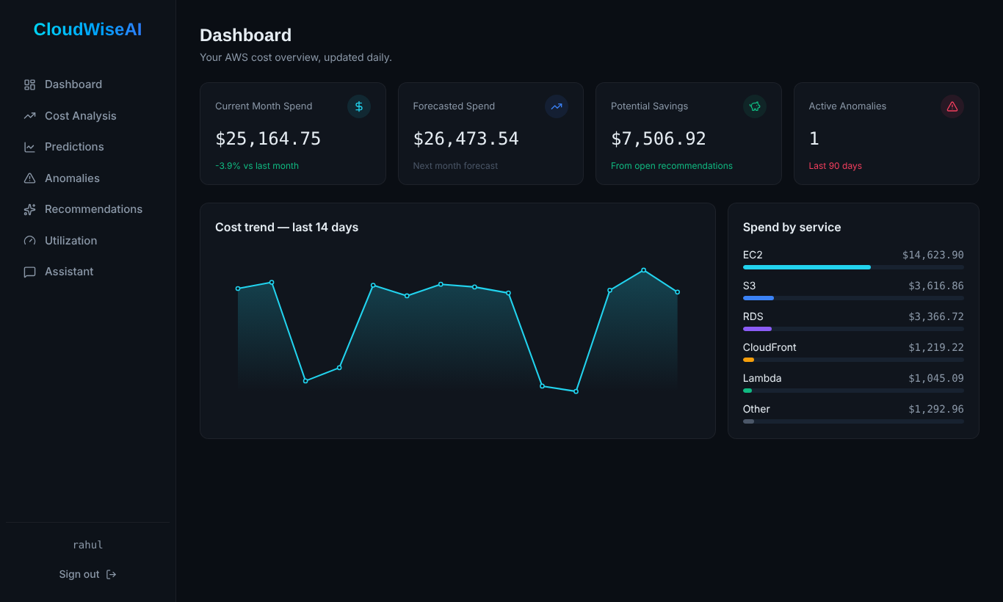
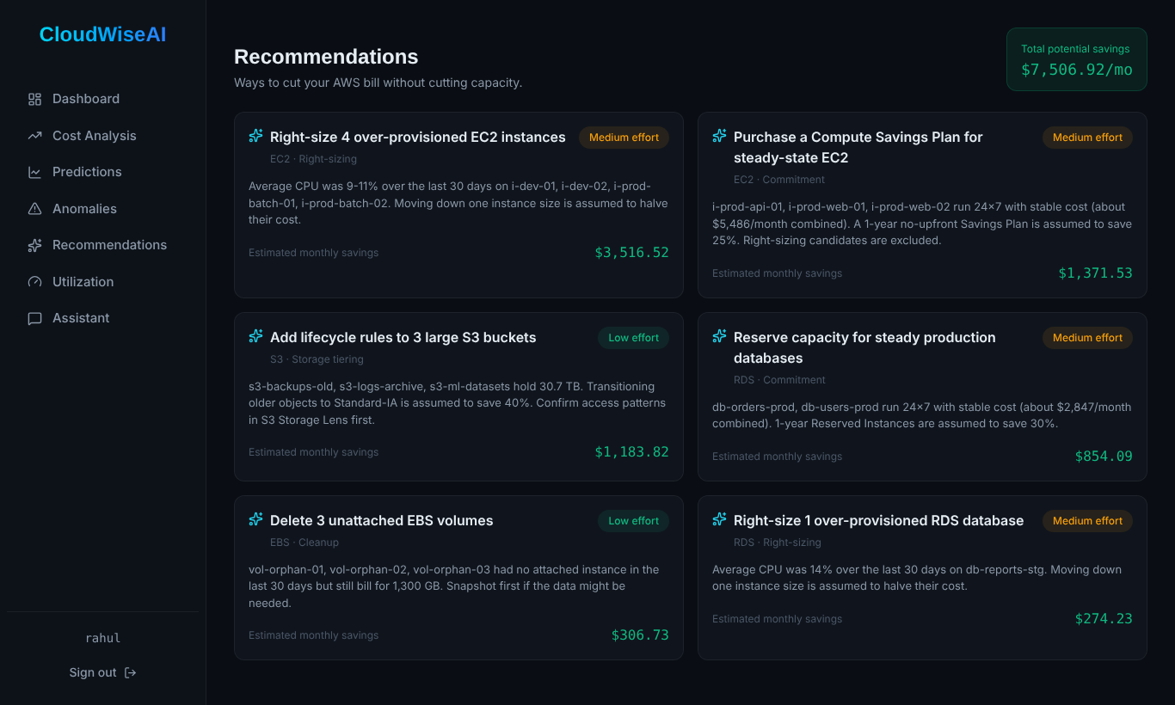
The dashboard, running against the loaded PostgreSQL data
Dashboard: spend, forecast, savings, anomalies
Recommendations with savings and effort
CloudWiseAI · BCSE355L · Local run, 16 Oct 2026 · Source: report, Figures 4 and 8
11
Notes:
These are real screenshots from the application running locally on 16 October 2026 against the PostgreSQL database loaded with the dataset. Other pages: cost analysis, utilization, anomalies, predictions and the assistant.

Slide 12
Security and testing
Security design
Testing
bcrypt password hashing and JWT tokens (24 hours)
11 of 14 test cases run locally on 16 Oct 2026: API, access control, input checks, repeatable data load, browser pages
Every data route requires sign-in
CORS limited to the frontend origin
3 AWS tests (live site, API health, alarm e-mail) not run until deployment
Assistant rate limited to 15 messages per minute
AWS design: private RDS, no SSH, IAM role with Session Manager
Setup script tested end to end on a local server; a second run adds no duplicate rows
CloudWiseAI · BCSE355L · Source: report, Sections 5.5 and 10.1
12
Notes:
Test table T01 to T14 is in the report. T09, T10 and T11 are the deployment checks and are marked not run.

Slide 13
AWS status: designed and scripted, live deployment next
Done
Next
Architecture and security design
Create RDS, EC2, API Gateway, S3, CloudFront
One-script EC2 setup (tested locally)
Run tests T09 to T11 and capture console evidence
Step-by-step deployment guide, teardown order
Keep spend inside new-account credits, then delete everything
CloudWatch and SNS alarm commands
Cost estimate: about $29 per month if run all month
CloudWiseAI · BCSE355L · Cost figure is an approximation · Source: report, Section 7
13
Notes:
Be direct: the AWS account is created and the kit is in the repository under src/aws, but the services themselves have not been created yet. The cost number is an approximate, unverified estimate for continuous running; the real spend for a short demo is a fraction of it and fits within the new-account credits.

Slide 14
Limitations and future work
Limitations
Future work
Synthetic data: the accuracy figures are optimistic and need real invoices
Deploy on AWS and run tests T09 to T11
Validate on a real Cost and Usage Report
Savings rest on stated assumptions
Lambda ingestion, SageMaker training, QuickSight
Single instance, port 8000 open behind API Gateway
VPC Link, load balancer with Auto Scaling, Multi-AZ RDS, Cognito, WAF
Assistant runs on a local model and can be wrong
CloudWiseAI · BCSE355L · Source: report, Sections 11 and 13
14
Notes:
The deliverable is a working, evaluated prototype, not a production service. State this before anyone asks.

Slide 15
Thank you
Questions?
github.com/rahulg1310/CloudWiseAI_Cloud_Project_2026
Rahul Ganesan · Ridhima Singh · Akhilesh Reddy
Notes:
Repository link for the code, dataset, results and the AWS deployment kit under src/aws.

